Slide 1
SS ZG622:
Software Project Management
(Project Scheduling)
Prof K G Krishna, BITS-Pilani Off-campus Centre, Hyderabad

Slide 2
Project Scheduling
Source Courtesy: Some of the contents of this PPT are sourced from materials provided by Publishers of T1 & T2

Slide 3


Text Books
T1: Pressman, R.S. Software Engineering : A Practitioner’s Approach, 7th Edition, TMH, 2010
T2: Hughes, B and Cotterel, M., Software Project Management, 11th Edition, TMH, 2011
S1: Frank Tsui, Managing Software Projects, Jones&Bartlett, 2011
S2: Pankaj Jalote, Software Project Management in Practice, Pearson Education, 2002
Note: In order to broaden understanding of concepts as applied to Indian IT industry, students are advised to refer books of their choice and case-studies in their own organizations

Slide 4
Project Scheduling
SS ZG622: Software Project Management – KG Krishna

Slide 5
Project Scheduling
Project scheduling is the process of deciding how the work in a project will be organized as separate tasks, and when and how these tasks will be executed.
You estimate the calendar time needed to complete each task, the effort required and who will work on the tasks that have been identified.
You also have to estimate the resources needed to complete each task, such as the disk space required on a server, the time required on specialized hardware, such as a simulator, and what the travel budget will be.

Slide 6
Project Scheduling Activities
Split project into tasks and estimate time and resources required to complete each task.
Organize tasks concurrently to make optimal
use of workforce.
Minimize task dependencies to avoid delays
caused by one task waiting for another to complete.
Dependent on project managers intuition and experience.

Slide 7
Milestones and Deliverables
Milestones are points in the schedule against which you can assess progress, for example, the handover of the system for testing.
Deliverables are work products that are delivered to the customer, e.g. a requirements document for the system.

Slide 8

The Project Scheduling Process

Slide 9
Scheduling problems
Estimating the difficulty of problems and hence the cost of developing a solution is hard.
Productivity is not proportional to the number of people working on a task.
Adding people to a late project makes it later because of communication overheads.
The unexpected always happens. Always allow contingency in planning.

Slide 10
Schedule representation
Graphical notations are normally used to illustrate the project schedule.
These show the project breakdown into tasks. Tasks should not be too small. They should take about a week or two.
Bar charts are the most commonly used representation for project schedules. They show the schedule as activities or resources against time.

Slide 11
Tasks, durations, and dependencies
Task | Effort (person-days) | Duration (days) | Dependencies
T1 | 15 | 10
T2 | 8 | 15
T3 | 20 | 15 | T1 (M1)
T4 | 5 | 10
T5 | 5 | 10 | T2, T4 (M3)
T6 | 10 | 5 | T1, T2 (M4)
T7 | 25 | 20 | T1 (M1)
T8 | 75 | 25 | T4 (M2)
T9 | 10 | 15 | T3, T6 (M5)
T10 | 20 | 15 | T7, T8 (M6)
T11 | 10 | 10 | T9 (M7)
T12 | 20 | 10 | T10, T11 (M8)

Slide 12
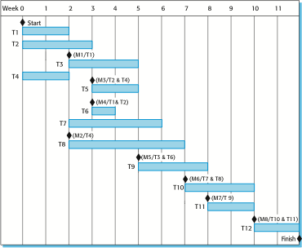
Activity bar chart

Slide 13
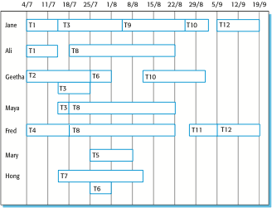
Staff (Resource) allocation chart

Slide 14
Thank You
Any Questions?

